Slide 1
HARNESS YOUR BODY’S ABILITY TO HEAL ITSELF
Regenerative Medicine
‹#›

Slide 2
WHAT IS REGENERATIVE MEDICINE?
WHAT TREATMENTS DO WE OFFER?
IS SURGERY YOUR ONLY OPTION?
ASK US YOUR QUESTIONS
‹#›

Slide 3
WHAT IS REGENERATIVE MEDICINE?
‹#›

Slide 4
The National Institute of Health defines Regenerative Medicine as a rapidly developing field that has the potential to transform the treatment of human disease and injury through innovative new therapies that offer faster and more complete recovery.
Moreover, Regenerative Medicine has significantly fewer side effects and risks of complication than surgery or drug therapies.
‹#›

Slide 5
Regenerative Medicine changes how we treat pain and injury.
Instead of treating pain and injury with surgery, implants and drugs, regenerative medicine harnesses your body’s own ability to heal faster and more completely.
‹#›

Slide 6
By building on what your body can do naturally, and stimulating it in a very powerful way through a protocol of injections and therapies.
Goal is to treat the cause of the pain instead of just the symptoms.
Regenerative Medicine
‹#›

Slide 7
Treatment Applications
Real Medicine for Real Healing.
Osteoarthritis
Pain Management Including Spine and Back
Cartilage Defects
Fractures
Degenerative Disc Disease
And more…
O s t e o a r t h r i t i s
a n d
O r t h o p e d i c
Regenerative Medicine
‹#›

Slide 8
Today’s field of regenerative medicine has truly learned to speak the body’s language, finding ways to treat previously untreatable injuries, better manage pain, and help the body heal faster and more effectively.
Therapies we offer:
A2M Therapy
Regenerative Medicine
‹#›

Slide 9
It’s estimated that approximately 27 million American adults suffer from some form of osteoarthritis (OA).
OA is a type of joint disease that results in the breakdown and destruction of cartilage – the connective tissue located between the bones of your joints that helps maintain smooth and painless movement. This is due to either mechanical or chemical causes.
‹#›

Slide 10
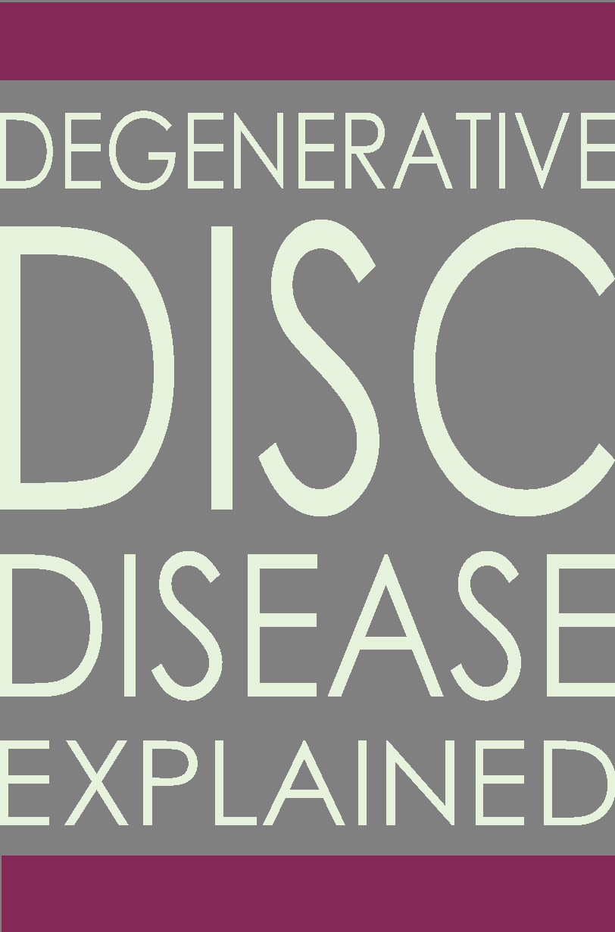
It’s estimated that approximately 3 million American adults suffer from some form of degenerative disc disease (DDD) per year!
Degenerative disc disease is the degeneration of the intervertebral disc and is a leading cause of Osteoarthritis of the spine, usually in the neck or lower back. Patients usually describe, symptoms of pain, and possibly radiating weakness or numbness stemming from a degenerated disc in the spine.
Degenerative spine conditions involve the gradual loss of normal structure and function of the spine over time due to aging, but may also be the result of tumors, infections or arthritis. Pressure on the spinal cord and nerve roots caused by degeneration can be caused by slipped or herniated discs.
‹#›

Slide 11
INTRODUCING
A2M
Therapy
‹#›

Slide 12
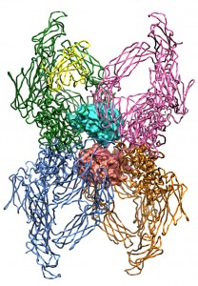
Non-Surgical Therapy for Osteoarthritis & Degenerative Disc Disease
Alpha-2-Macroglobulin (A2M) is a recently discovered compound that stops and reverses the destruction of the cartilage caused by osteoarthritis (OA).
A2M Therapy
‹#›

Slide 13
A2M works like a Venus flytrap by having a bait and trap mechanism.
Once the damaging proteins are bound on both sides, the A2M molecule initiates a “suicide cascade” and dies, allowing it to be flushed out of the body
A2M Therapy
‹#›

Slide 14
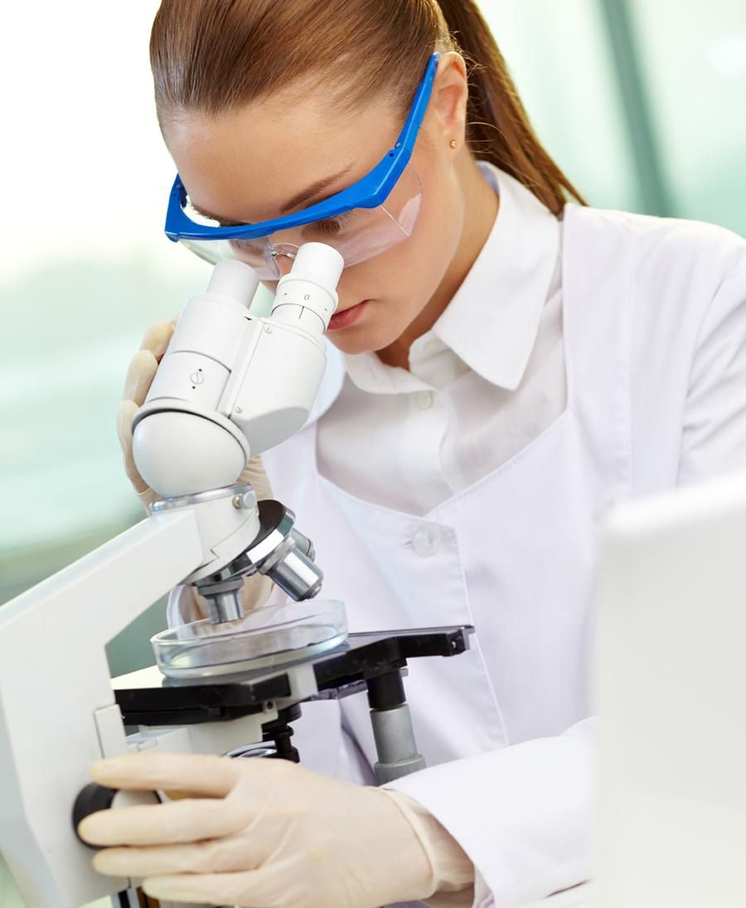
New Diagnostic Test
A recently discovered, protein biomarker called Fibronectin-Aggrecan Complex (FAC) has been identified in the painful inflammation of degenerative discs and joints.
FAC Test is used to detect the presence of the protein biomarker FAC from a small fluid specimen taken from the painful joint.
FAC+ patients are identified as ideal candidates for A2M therapy and have a 90% chance of responding.
FAC Pain Diagnostic
‹#›

Slide 15
Early Treatment. Better Results.
A2M is an exciting advancement in orthopedic science resulting from years of osteoarthritis research.
A patented and proprietary filtration process has been developed to concentrate the naturally occurring A2M molecule in your blood up to 6X!
Early treatments can postpone the need the need for more aggressive and costly joint reconstruction or replacement surgery.
A2M Therapy
‹#›

Slide 16
optimum
recovery
Research shows regenerative medicine is extremely effective.
There are no known side-effects.
Patients respond quickly without the downtime and missed work from surgery.
‹#›

Slide 17
What’s the Cost?
Most of us are too busy living life to afford the downtime and missed work from surgery.
The cost of regenerative medicine is relatively inexpensive, especially when you consider the cost of surgery in both medical bills and in lost wages.
‹#›

Slide 18
Is Surgery Really Your Only Choice?
NO!
‹#›

Slide 19
The Alternative to Surgery
By building on what your body can do naturally, and stimulating it in a very powerful way through a protocol of injections and therapies, regenerative medicine can provide healing without the stress, cost, and downtime of surgery.
That’s huge for active people like you who can’t afford to put their lives on hold for a prolonged period of time.
‹#›

Slide 20
ASK US
Are You a Candidate for Regenerative Medicine?
‹#›

